Slide 1
INDIAN TOURISM WEBSITE
Submitted To: Nagamani K.

Slide 2
Presented by-
Supriya Vyavhare
Durvesh Ture
Mukesh Tajne
Priyanka Walnekar
Reshma Zaware
Snehal Shipalkar
Akshay Shinde
Ragini Yadav

Slide 3
INTRODUCTION
Indian tourism website information system.
Users can get information at their finger tips.
Provide various advantages of our tourist system to users through our website.
We provide valuable services in favor of our users.

Slide 4
OBJECTIVE
Easy to fetch information of places from our website.
Virtually explore places in India.
We provide images of almost all the places.
We provide information about famous tourist points, accommodations, shopping attractions, etc.

Slide 5
We also provide information about Tourist Guides.
We guarantee genuine information.

Slide 6
TECHNOLOGY
HTML
CSS

Slide 7
REQUIREMENTS
Hardware Used :
1.Processor: To run this system efficiently we need processing power of Pentium core2duo or other advance processors.
2. RAM: Required 1GB or more.
3. Hard disk: Required 32GB or more.
Software Used:
HTML viewer
kompozer

Slide 8
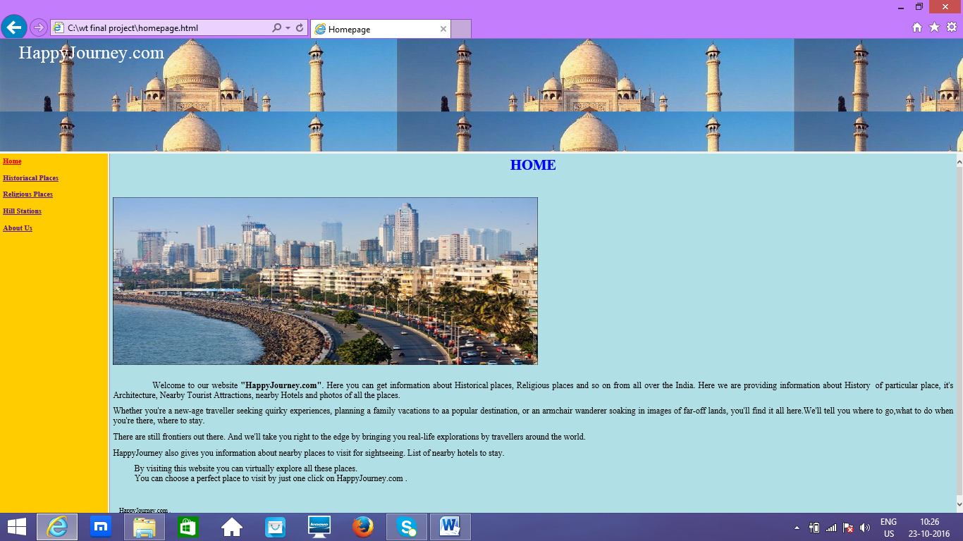
HOME PAGE

Slide 9
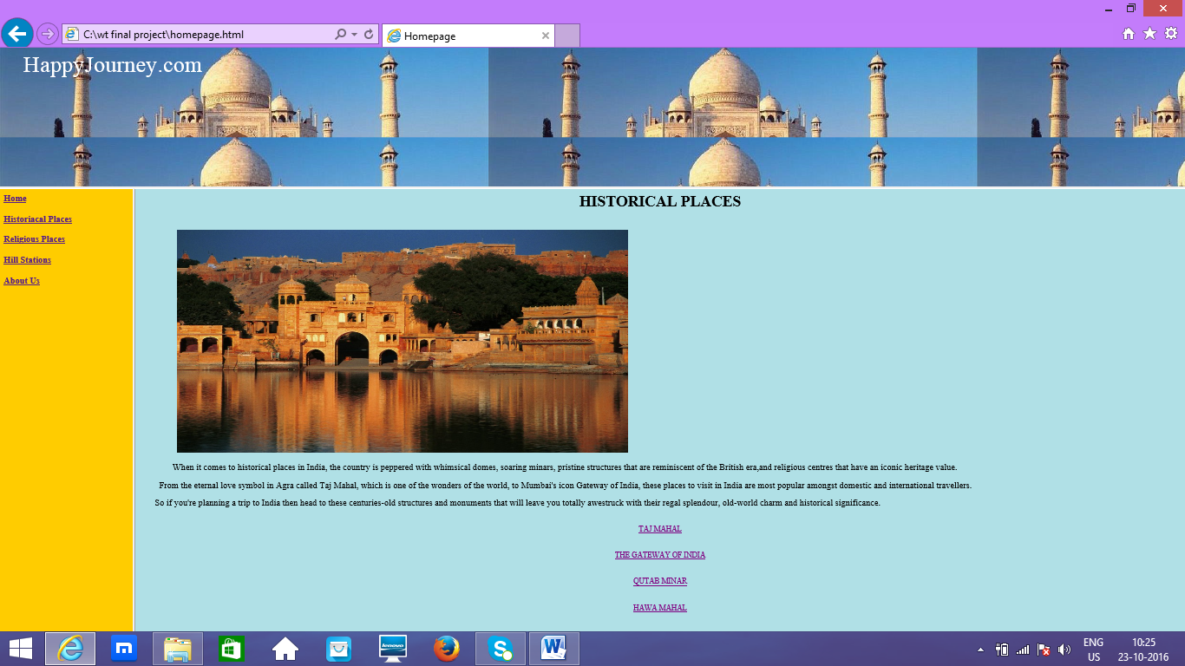
HISTORICAL PLACES

Slide 10
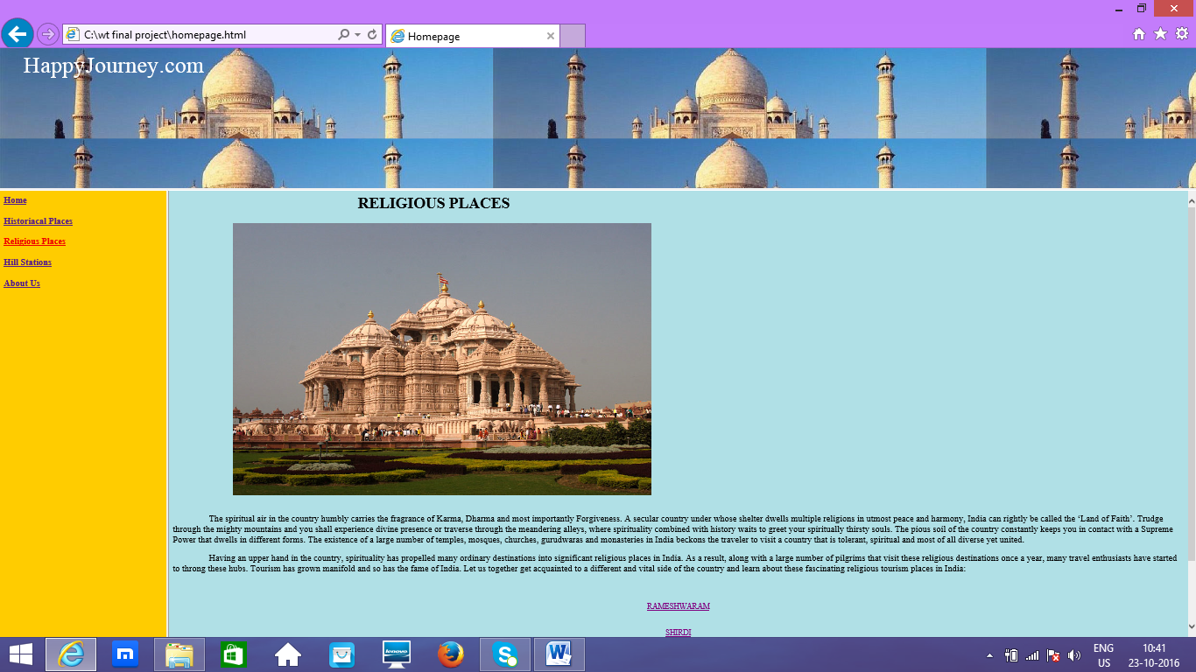
RELIGIOUS PLACES

Slide 11
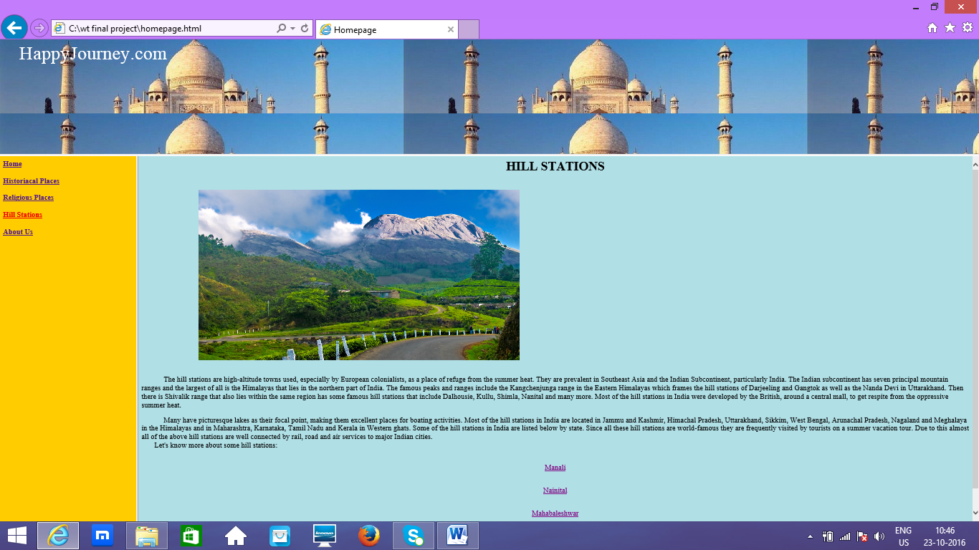
HILL STATIONS

Slide 12
ADVANTAGES
Anyone can edit through approval of owner.
Easy to use and learn.
We keep track of every editing's made and revert back to the previous version if needed.

Slide 13
Number of people can visit the website at the same time.
Reliable website
High performance website.
Flexible

Slide 14
LIMITATIONS
Network issues (for connection oriented system).
Connection less method is less secure.
Security can be further improved by using biometric features for authentication of website information.

Slide 15
CONCLUSION
The project entitled tourism agency system was completed successfully. The system is developed with much care and free of errors and at the same time it is efficient and less time consuming.
The purpose of this project is to develop a website for displaying detailed information about various tourist places in India.

Slide 16
This project helps in gaining valuable information and knowledge about several tourist places.
This project provides history, geographical data, culture and architecture about the places.

Slide 17
REFERENCE
http://www.google.com
http://www.wikipedia.com

Slide 18


Slide 19

ANY QUESTIONS ?

